Slide 1
Azure ARM template and Serverless computing

Slide 2
Azure Resource Manager (ARM)
ARM templates is a service provided by Microsoft Azure that allows you to provision, manage, and delete Azure resources using declarative syntax.
These templates can be used to deploy and manage resources such as virtual machines, storage accounts, and virtual networks in a consistent and reliable manner.
To deploy the template, you can use the Azure Portal, Azure CLI, or Azure PowerShell and Azure Button.

Slide 3
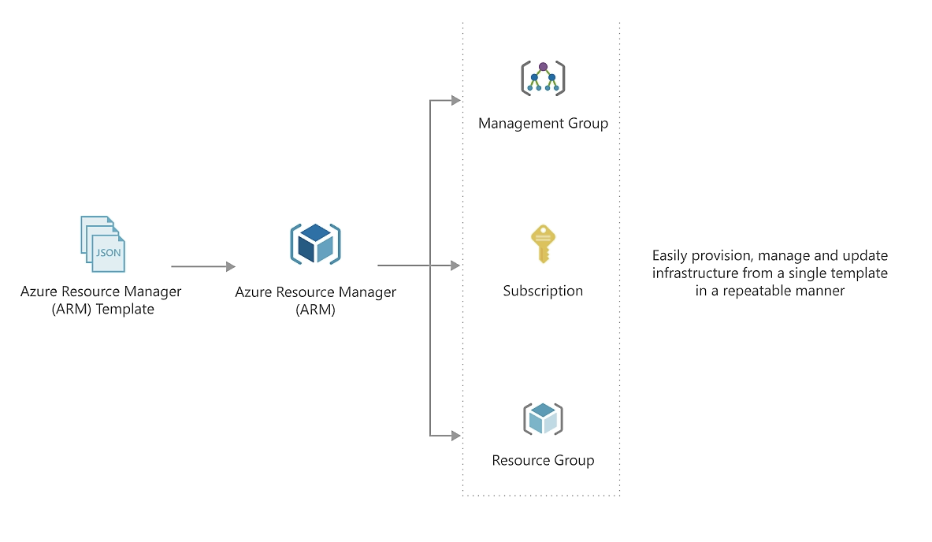

Slide 4
Why choose ARM templates?
Declarative syntax:
ARM templates allow you to create and deploy an entire Azure infrastructure declaratively.
Repeatable results:
Repeatedly deploy your infrastructure throughout the development lifecycle and have confidence your resources are deployed in a consistent manner.
Orchestration:
Resource Manager orchestrates the deployment of interdependent resources so they're created in the correct order.
There is no complexities of ordering operations.

Slide 5
Modular files:
You can break your templates into smaller, reusable components and link them together at deployment time.
You can also nest one template inside another template.
Create any Azure resource:
You can immediately use new Azure services and features in templates.
As soon as a resource provider introduces new resources, you can deploy those resources through templates.
Extensibility:
With deployment scripts, you can add PowerShell or Bash scripts to your templates. The deployment scripts extend your ability to set up resources during deployment.

Slide 6
Testing:
You can make sure your template follows recommended guidelines by testing it with the ARM template tool kit (arm-ttk).
Preview changes:
You can use the what-if operation to get a preview of changes before deploying the template.
With what-if, you see which resources will be created, updated, or deleted, and any resource properties that will be changed.
Built-in validation:
Your template is deployed only after passing validation.
Resource Manager checks the template before starting the deployment to make sure the deployment will succeed.

Slide 7
Tracked deployments:
In the Azure portal, you can review the deployment history and get information about the template deployment.
Policy as code:
Azure Policy is a policy as code framework to automate governance. If you're using Azure policies, policy remediation is done on non-compliant resources when deployed through templates.
Deployment Blueprints:
You can take advantage of Blueprints provided by Microsoft to meet regulatory and compliance standards. These blueprints include pre-built templates for various architectures.

Slide 8
Exportable code:
You can get a template for an existing resource group by either exporting the current state of the resource group, or viewing the template used for a particular deployment.
Viewing the exported template is a helpful way to learn about the template syntax.
CI/CD integration:
You can integrate templates into your continuous integration and continuous deployment (CI/CD) tools, which can automate your release pipelines for fast and reliable application and infrastructure updates.
Authoring tools:
You can author templates with Visual Studio Code and the template tool extension.
You get intellisense, syntax highlighting, in-line help, and many other language functions.

Slide 9
Deploying ARM templates
Here we’ll use the Azure Portal to create, deploy and export resources using ARM templates:
The first thing you need to do is to search for the service .
After selecting the service, you’ll see the options:
Build your own template in the editor
Common templates
Start with a quickstart template or template spec.
Begin with a quickstart template.

Slide 10
Add the required parameters, such as resource group, username, DNS, and password and create.
You can also modify the template based on your requirements before creating the resources.
Once the deployment is successful, you can go to the selected resource group, and you’ll see the created resources from the ARM template.
When the Azure resources are no longer needed, you can clean up the resources by deleting the resource group.

Slide 11
Exporting Template
If you want to save the current state of the resource group, scroll down to the Automation section and click Export template, then click the download button.
Before re-using the template for production deployments, you may want to revise it since the template we used is a quickstart template.

Slide 12
What is Serverless Computing?
Serverless computing provides inbuilt infrastructures and a runtime environment to develop applications rapidly.
It is the next-generation evolution of Platform as a Service. There is no need to worry about infrastructure, scaling, management, and provisioning at all.
You can manage real-life applications also and pay for the resources you consume.
Whenever the application is in an idle state, you are not charged for it.

Slide 13
Azure Serverless Computing
Azure comes up with built-in intelligence to enable user’s code with machine learning and cognitive services.
It helps in developing intelligent and building smart applications.
Azure serverless computing offers to create endless connections, which means users can use multiple functionalities from various sources.
It provides local debugging in visual studio, Visual debug history, deployment, etc. It can boost the productivity of any organization.

Slide 14
Microsoft Azure Serverless Architecture
Users go to their browser to access the application and sign in. Now, the browser starts pulling the static resources like images from Azure CDN (Content Delivery Network).
Users make use of SQL queries to search various products from the database.
This time, the website pulls the product catalog from the database and product images from blob storage.

Slide 15
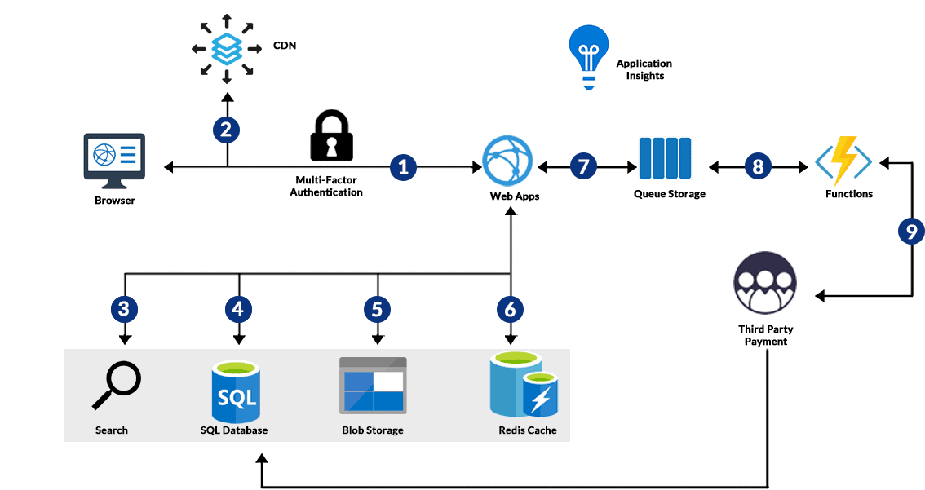

Slide 16
To provide a better performance, Azure cache for Redis cached the page output.
The Azure function makes payments to the third party and stores the record in the SQL database.
Users submit their orders and order is placed in a queue. Now it’s the turn of the Azure function to process the payment.

Slide 17
Advantages of Azure Serverless Computing
Developers can code in any language of their choice without worrying about the servers.
Users can use Azure Cosmos DB for storing the data of their serverless applications.
Microsoft Azure provides top-notch security to developers. Azure Active Directory helps developers to access resources securely and manage their serverless applications.
Microsoft Azure provides scalable cloud storage for developers.
It helps in Cloud Messaging.
It provides API management and so many other services.

